Slide 1

CSC120 LAB – COMPUTER PROGRAMMING 1
WEEKLY LAB
Everett

Slide 2

WEEK 4 – LAB 3
CSC120
LAB
Monday 2/3/2025
Calculation with Math Functions
Lab Instructor:
Everett

Slide 3
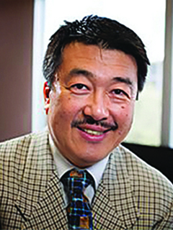
CSC120 Lecture Professor
Dr. Mitsunori Ogihara
Professor
Office: Ungar Building, Room 310F
E-mail: mogihara@miami.edu
Office Hours: T
https://people.miami.edu/profile/9930bd3ea82f8adb34c87a31680b79c4

Slide 4

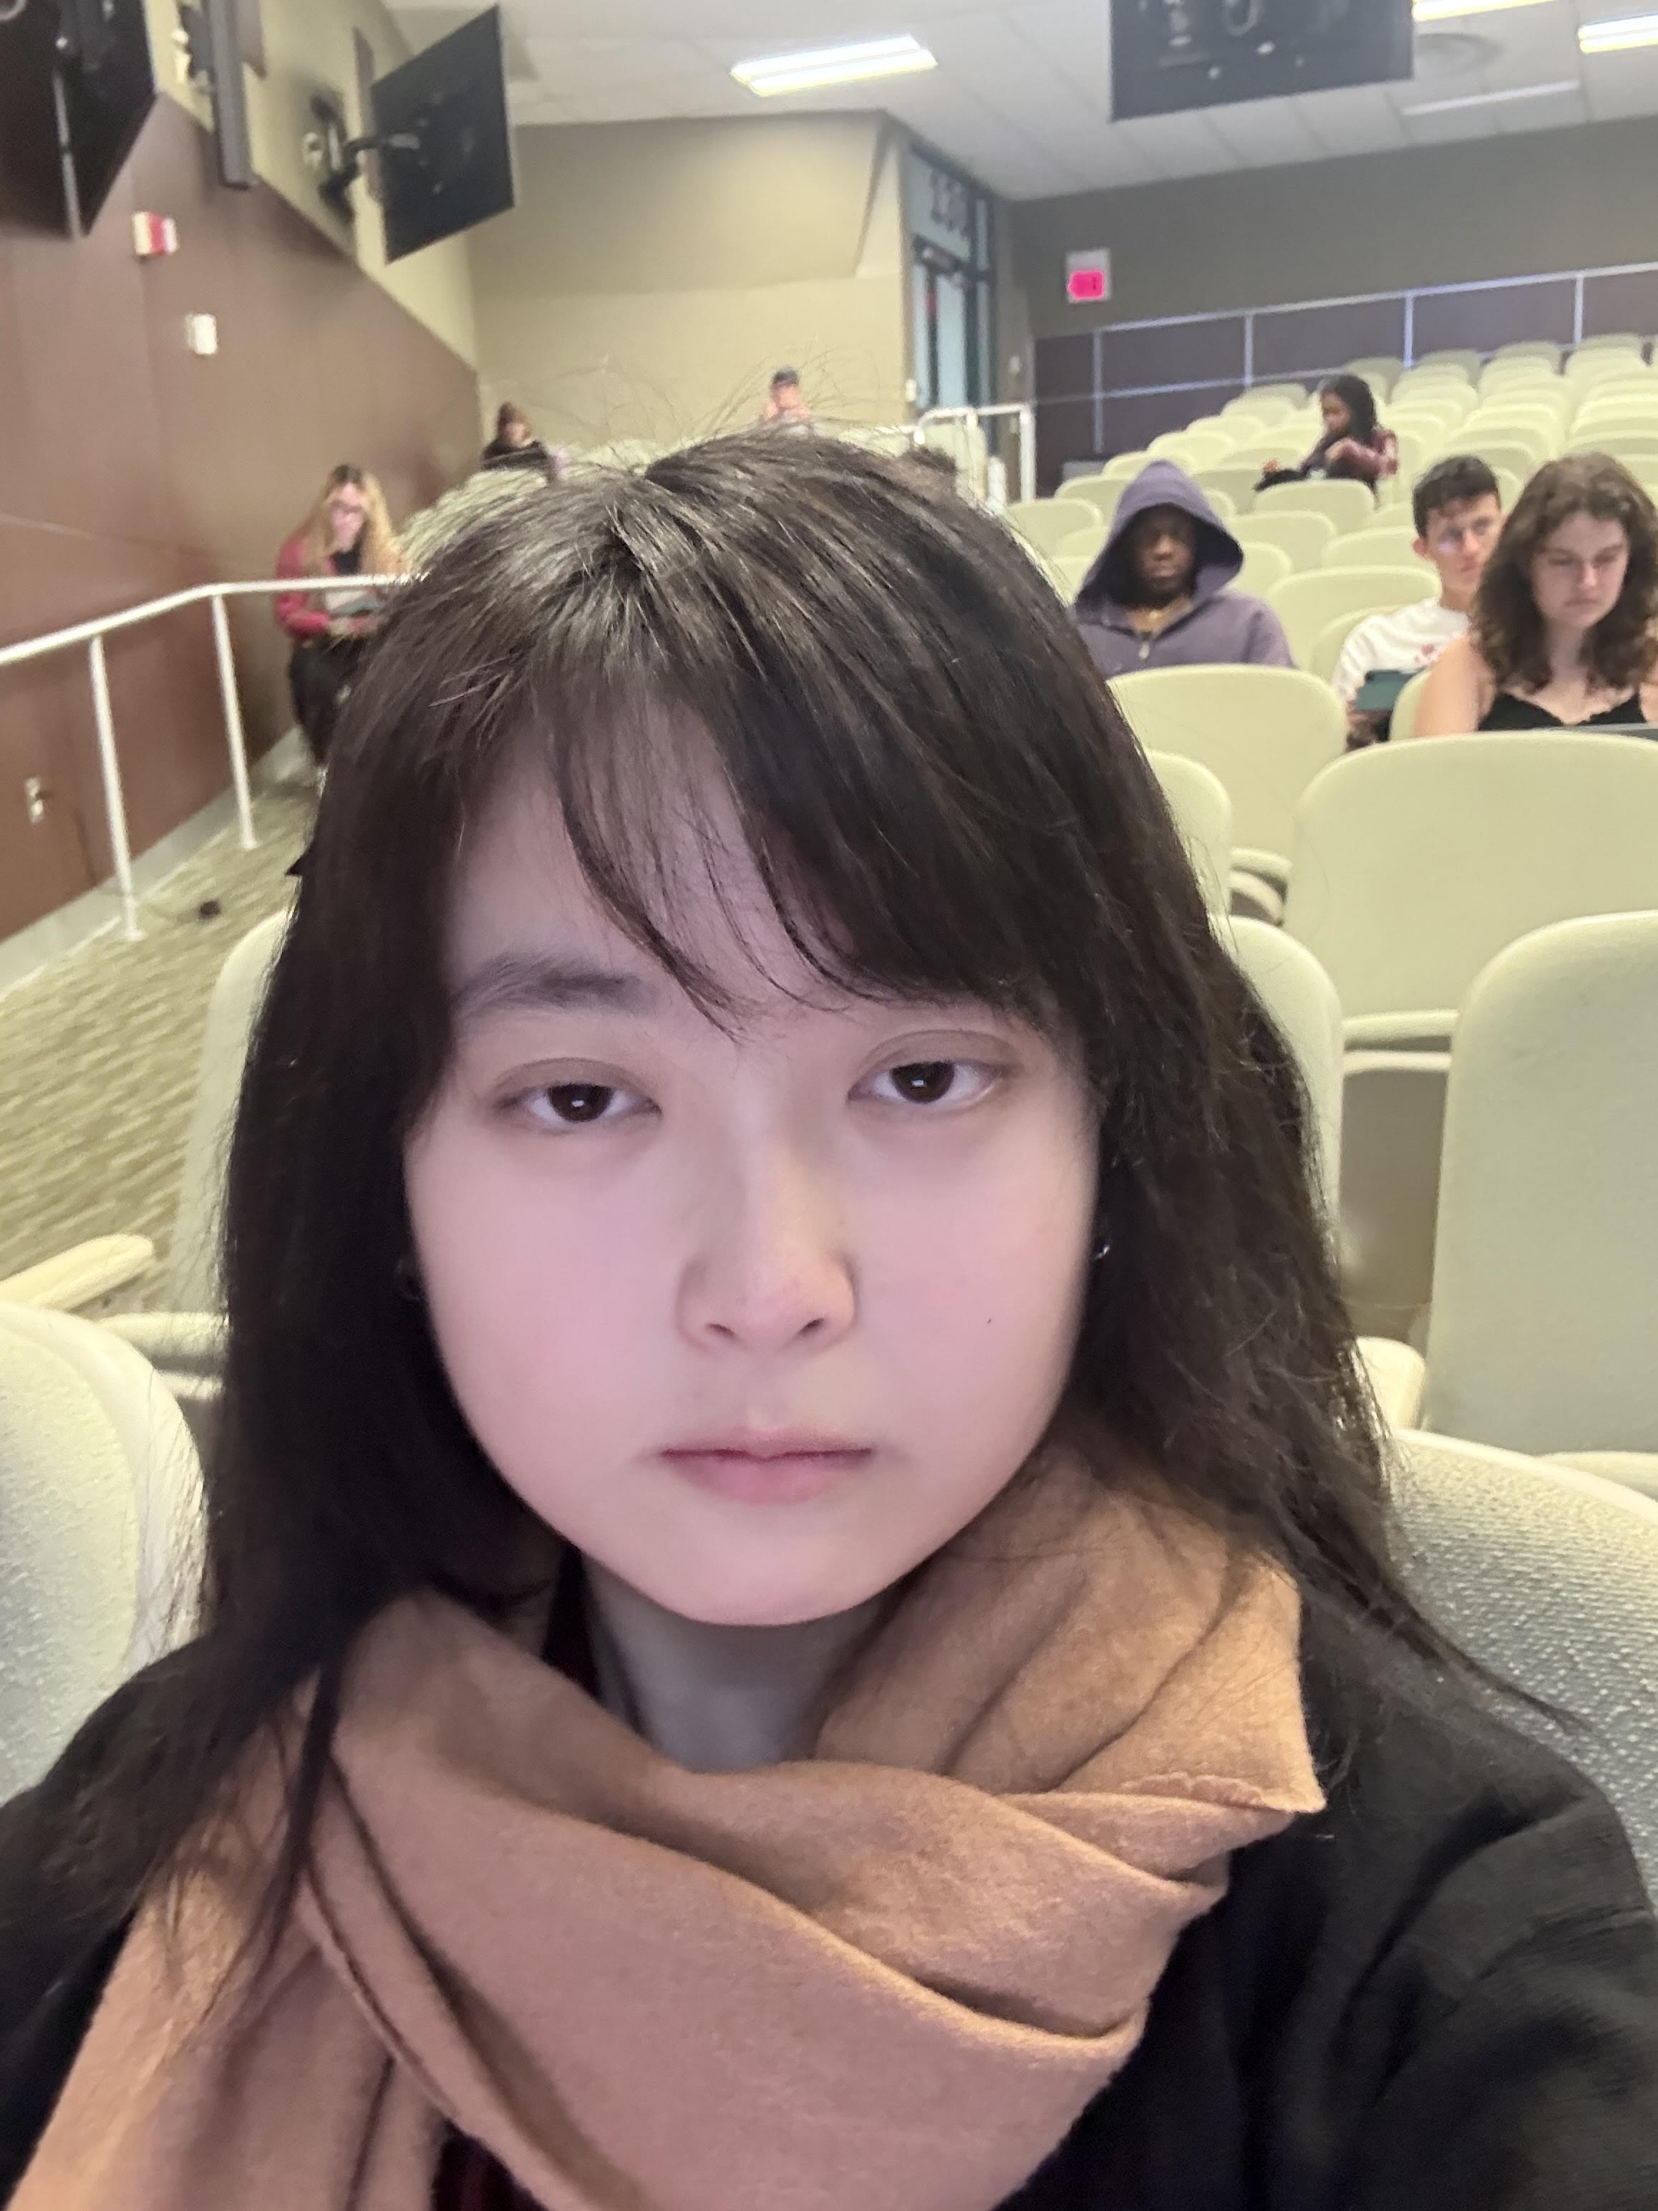
LAB Instructor & TAs
Everett
Teaching Assistant
Office: Ungar Building, Room 310T
E-mail: yxx644@miami.edu
Office Hours: Wednesday 11am-4pm
Teaching Assistants & their office hours at Ungar Building, room 310T
Martineulr Decastro Marasigan : Thursday 11am -12 pm
Esteban Isaac Morales : Thursday 2pm-3pm
Fakhir Ahmed Aslam : Tuesday 1pm -2pm
Dr. Hien Nguyen
Office Hours: Monday from 7am – 8:00am
Tuesday from 10am – 12:00pm,
Thursday from 10am – 12pm,
or by appointment

Slide 5
TODAY’S LAB

Slide 6
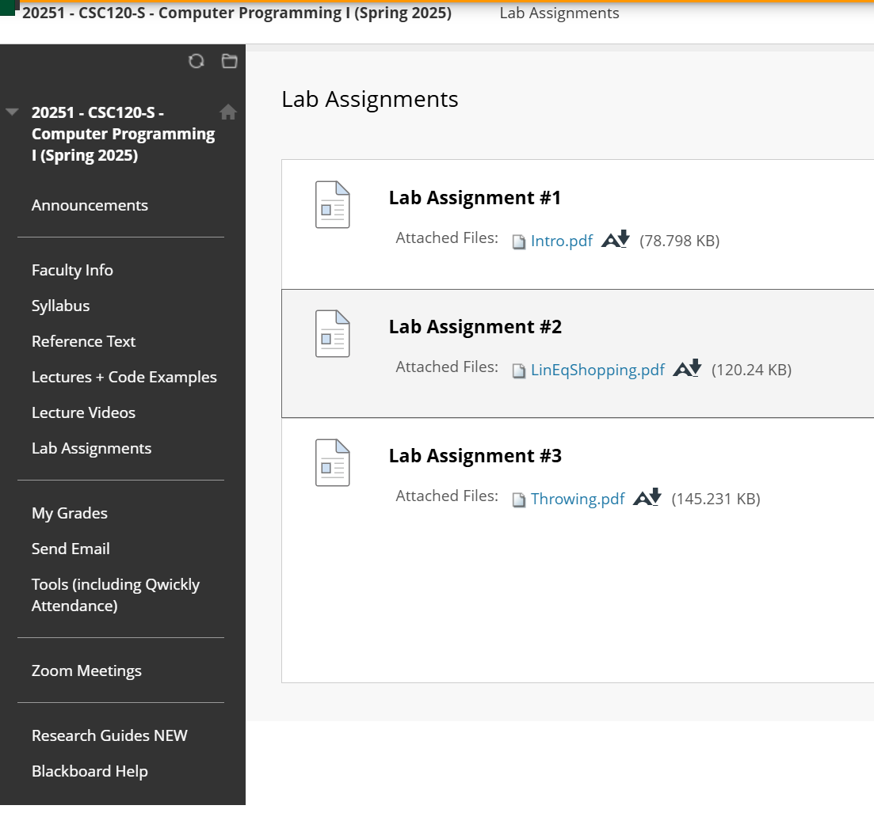
TODAY’S LAB

Slide 7
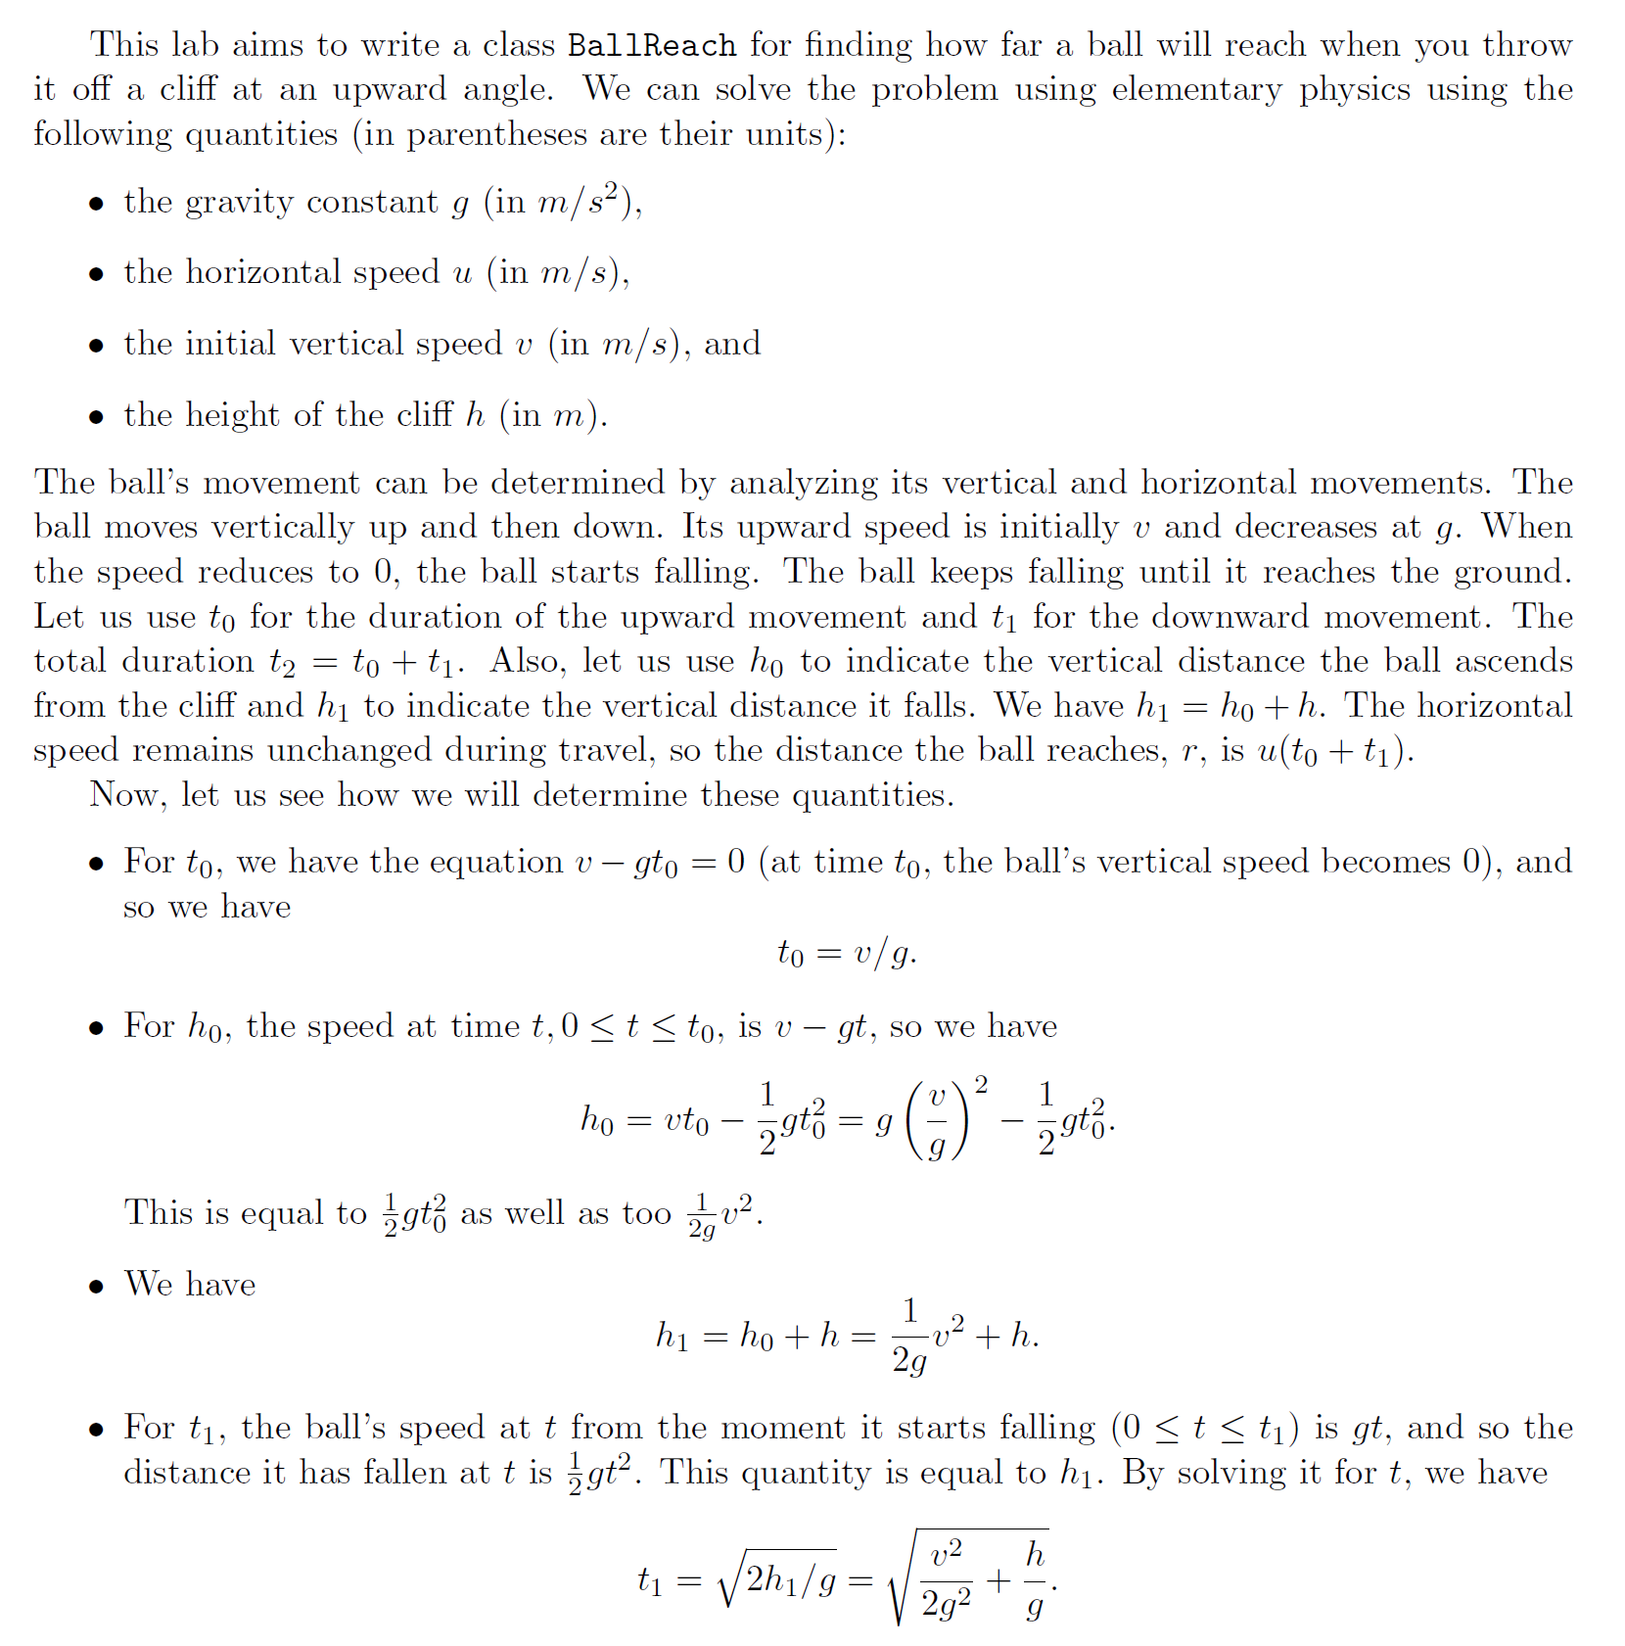
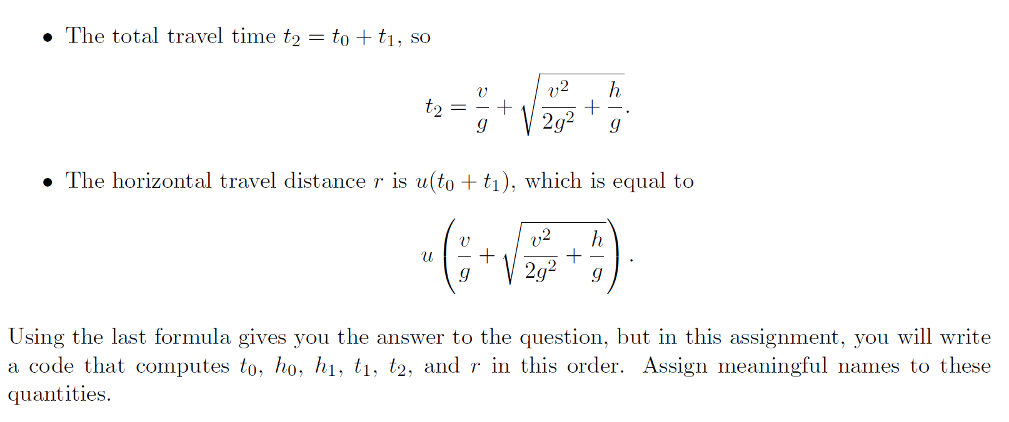
TODAY’S LAB

Slide 8
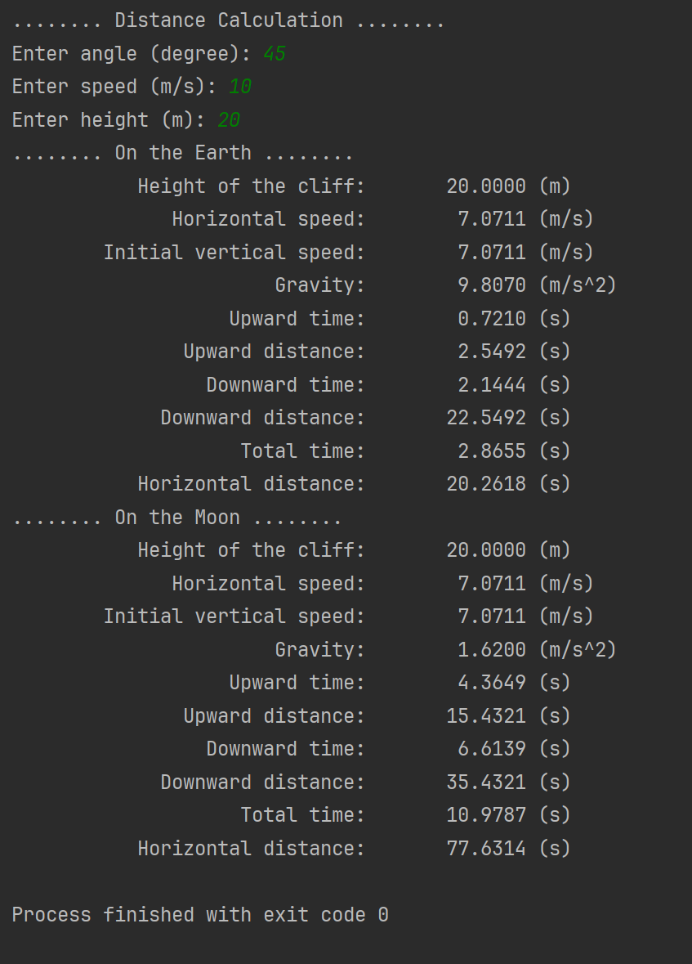
TODAY’S LAB
Test Data & Result

Slide 9
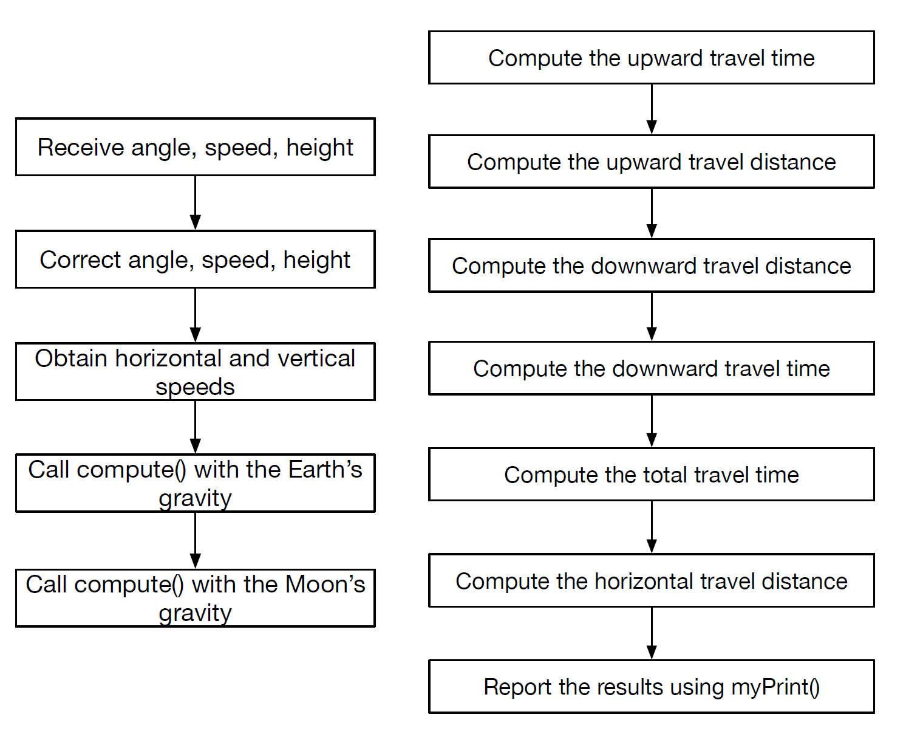
TODAY’S LAB HINT
Use Input – Process – Output (I.P.O.)

Slide 10
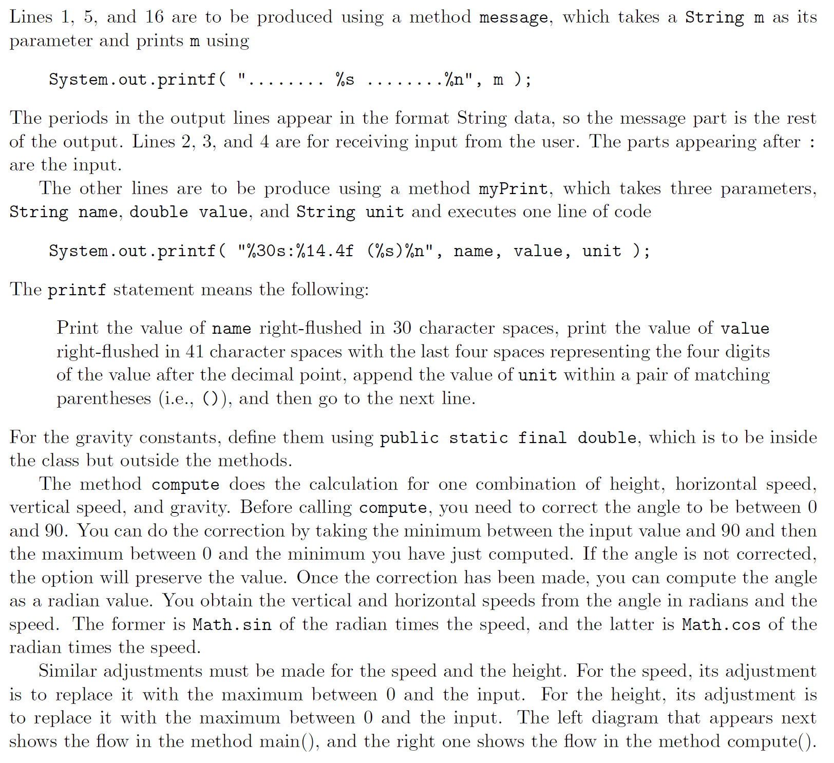
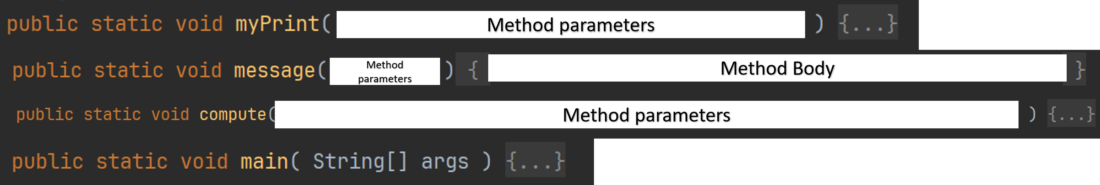
TODAY’S LAB HINT
List of Methods
The main Method

Slide 11
Method parameters
Method parameters
Method Body
Method parameters

Slide 12
TODAY’S LAB
Test Data & Result

Slide 13
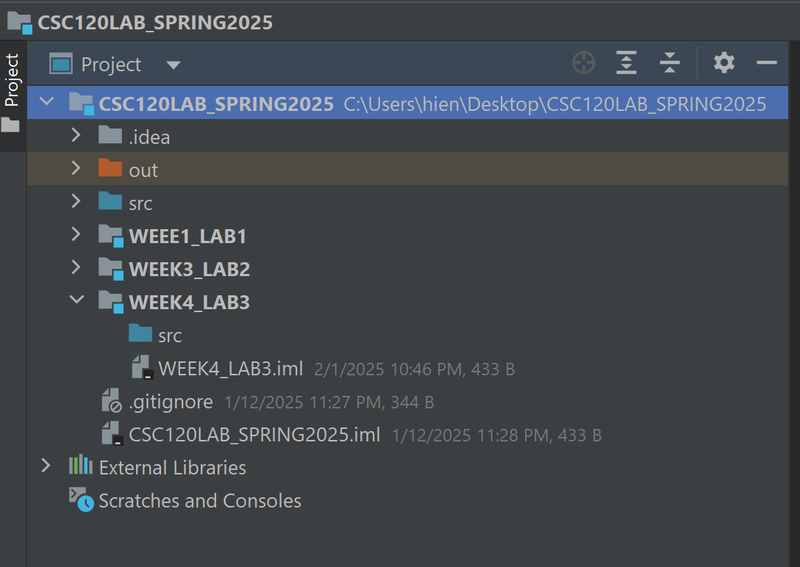
Let’s Begin…

Slide 14
REVIEW & PRACTICE CODING

Slide 15
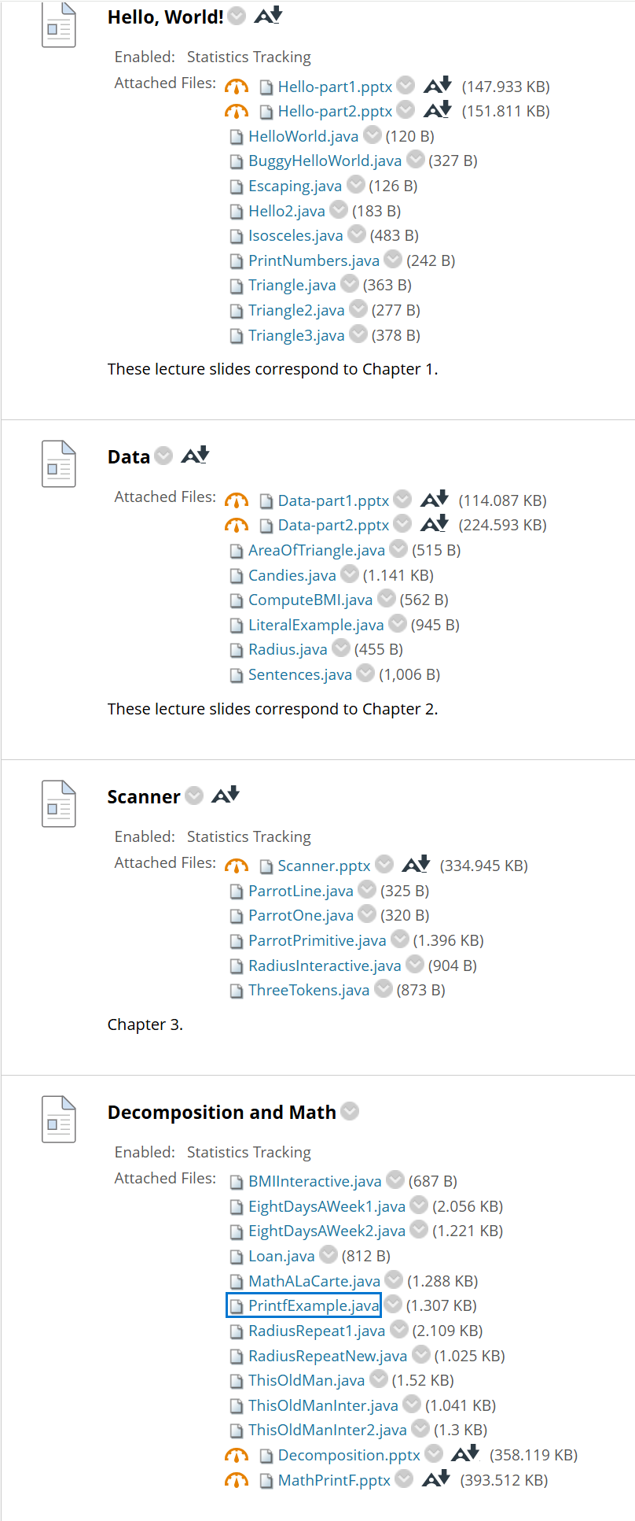
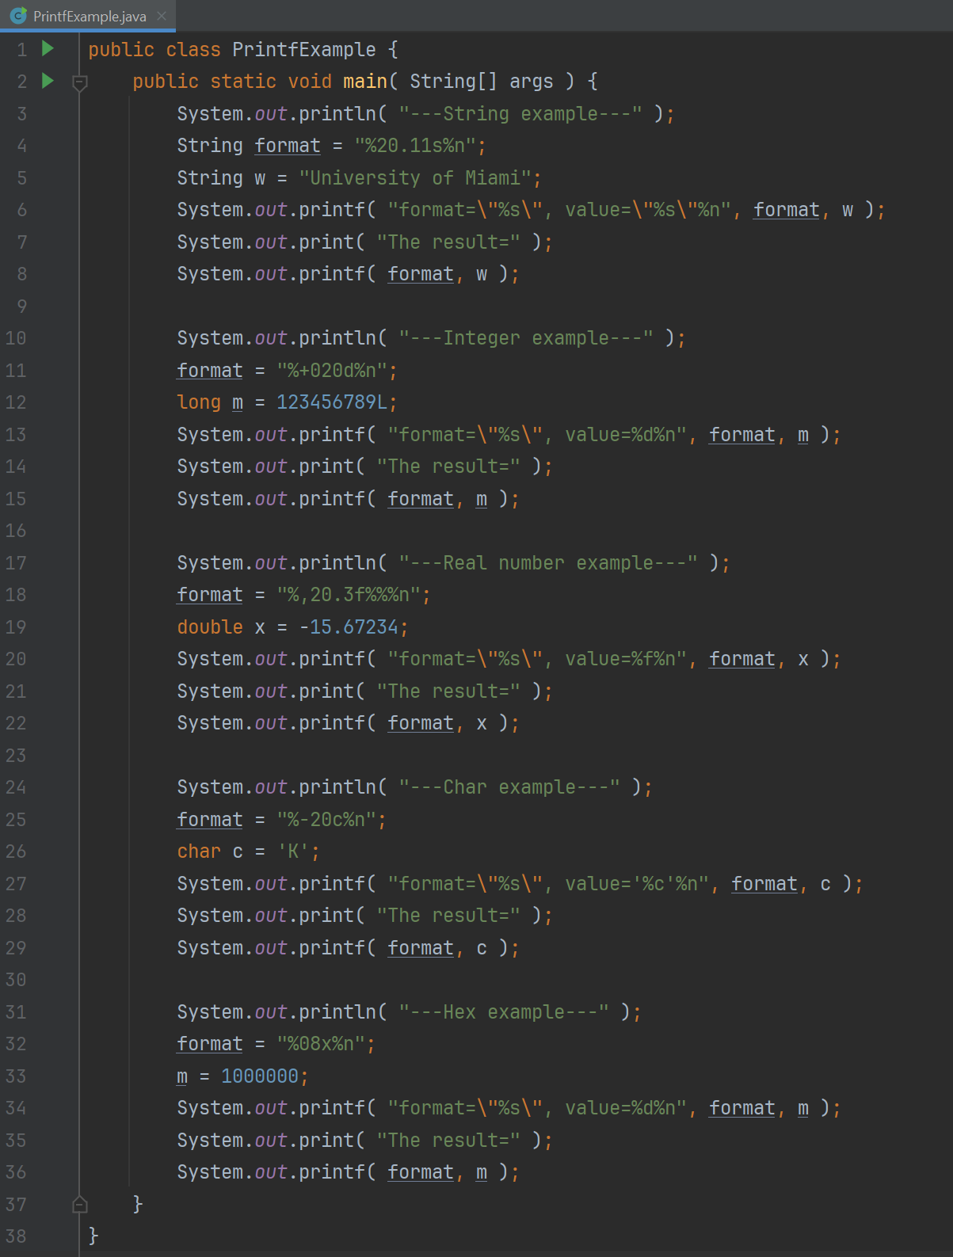
REVIEW & PRACTICE CODING

Slide 16
Methods Review &
REMINDER
void method
return data method
Calling a method

Slide 17
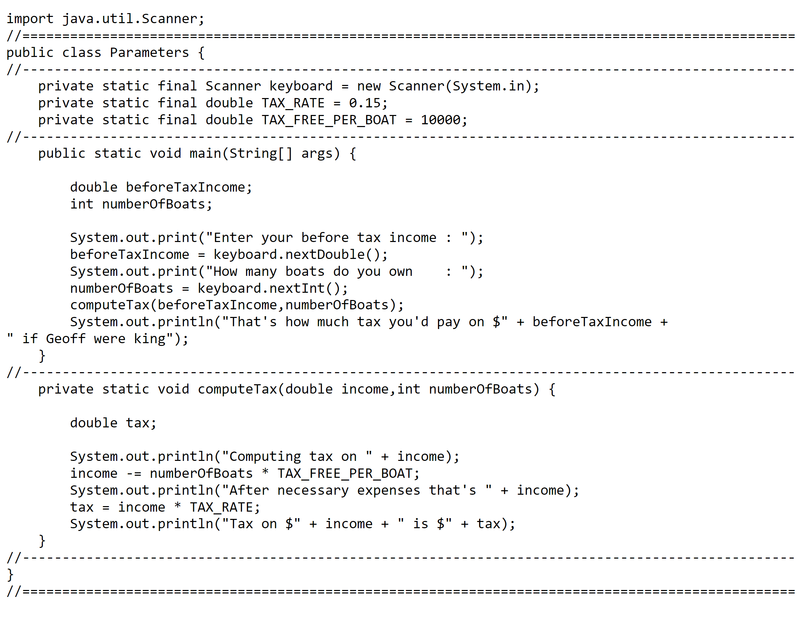

Slide 18
